Slide 1

BMW Car Sales Data Analysis Project
Data Analytics Project | Python | Visualization

Slide 2



Project Overview
Objective
Tools Used
Skills Demonstrated
Analyze BMW car sales dataset to uncover market trends, pricing patterns, and consumer preferences in the luxury automotive segment.
Python ecosystem including Pandas for data manipulation, Matplotlib and Seaborn for advanced statistical visualization.
End-to-end data pipeline: cleaning, transformation, exploratory analysis, visualization, and actionable reporting.

Slide 3

Dataset Overview
Dataset Characteristics
Analysis Goals
Identify critical pricing patterns, model popularity trends, and key factors influencing resale value in the luxury car market.
Source: Comprehensive BMW sales dataset with transaction records
Key Fields: Price, Mileage, Model, Year, Fuel Type, Transmission, Engine Size
Extract actionable insights for pricing strategy, inventory optimization, and market positioning.
Scope: Multi-year sales data across various BMW model lines

Slide 4
Data Preprocessing
01
02
Data Quality Assessment
Duplicate Removal
Identified and handled missing values using statistical imputation methods. Ensured data completeness across all critical fields.
Detected and eliminated duplicate records to ensure accuracy. Validated unique transaction identifiers.
03
04
Format Standardization
Feature Engineering
Normalized data formats for mileage, year, and pricing fields. Converted units to consistent standards for analysis.
Created derived variables including vehicle age, price per mile, and depreciation rates to enhance analytical depth.

Slide 5
Exploratory Data Analysis
1
2
3
Price Distribution
Model Comparison
Mileage Impact
Analyzed pricing patterns across the entire dataset, identifying median, quartiles, and outliers in the BMW market.
Calculated average prices by model series (3-Series, 5-Series, X-Series) to understand segment positioning.
Examined the relationship between odometer readings and resale value using correlation analysis.
4
5
Depreciation Trends
Feature Comparisons
Tracked year-over-year price depreciation to quantify value retention across model years.
Evaluated pricing differences between transmission types (manual vs automatic) and fuel variants (petrol vs diesel).

Slide 6
Key Insights
Mileage-Price Correlation
Model Year Premium
Strong negative correlation (-0.72) between mileage and price. Every 10,000 miles reduces resale value by approximately 8-12%.
Newer models (0-3 years old) command significantly higher resale values, retaining 65-75% of original MSRP.
Transmission Premium
Fuel Type Stability
Automatic transmission vehicles average 15-20% higher prices than manual equivalents across all model lines.
Diesel variants demonstrate superior long-term resale stability, depreciating 5-8% slower than petrol models over 5 years.

Slide 7

Visualization Insights: Price & Mileage Analysis
0-20
20-40
40-60
60-80
80-100
100+
The visualization clearly demonstrates the inverse relationship between mileage and pricing. Lower mileage vehicles command premium prices, with the steepest depreciation occurring in the 0-60k mile range.

Slide 8
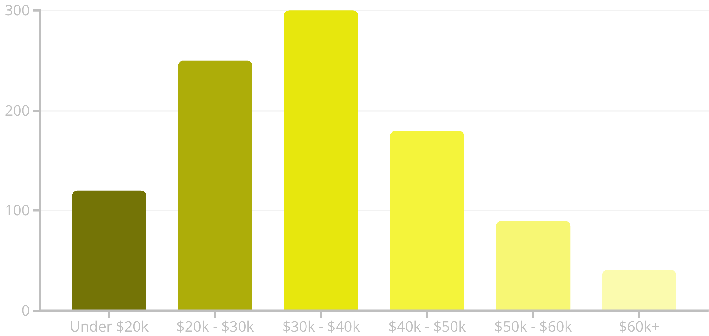
Price Distribution Analysis
The visualization above shows the distribution of car prices across the dataset. This histogram, titled "Distribution of Car Prices", with axis labels for Price and Count, clearly illustrates the spread of prices in the BMW sales dataset. It reveals that a significant portion of vehicles falls within the $20,000 - $40,000 range, representing a key market segment. The distribution tapers off at higher price points, indicating fewer ultra-luxury models, while still showing a notable presence in the premium $40,000 - $60,000 segments. This analysis is crucial for understanding pricing patterns and identifying potential market opportunities.

Slide 9
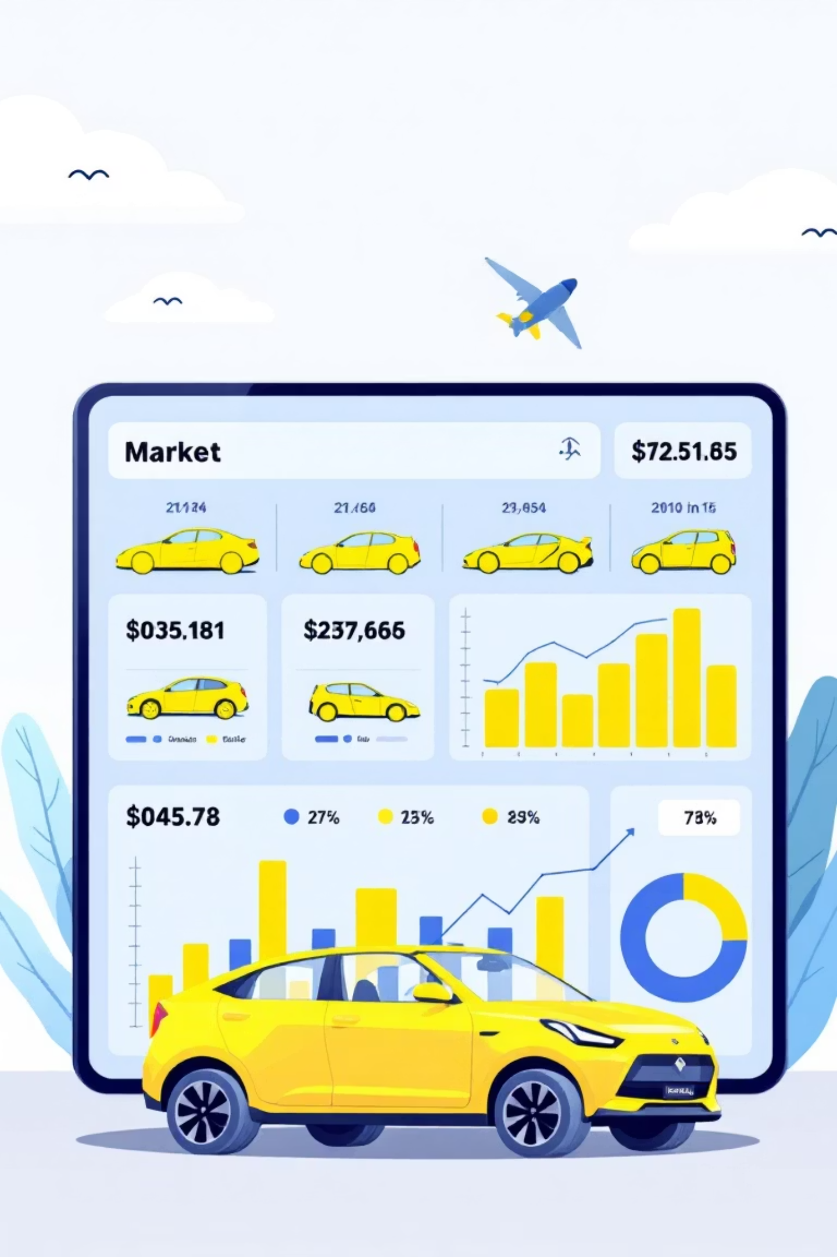
Market Intelligence: Data-Driven Insights
42%
18K
3.2
Price Premium
Average Depreciation
Years to Break-Even
Average price difference between newest models (0-2 years) and older vehicles (5+ years)
Dollar value lost in first three years of ownership across all BMW models analyzed
Average time for diesel models to offset higher purchase price through better resale value
Strategic Recommendations
Market Opportunities
Newer model acquisitions show strongest ROI potential
Target low-mileage vehicles for premium inventory
Mid-mileage range (40-60k) offers best value proposition
Prioritize automatic transmission models for faster turnover
Premium features significantly impact resale performance
Consider diesel variants for long-term value retention

Slide 10

Conclusion
Project Outcomes
This comprehensive analysis successfully reveals critical market behavior patterns for BMW vehicles, providing data-driven insights into pricing dynamics and consumer preferences.
The findings enable accurate resale price prediction models and inform strategic decisions for dealers, buyers, and market analysts.
Technical demonstration: Strong proficiency in Python-based data analysis, statistical visualization, and translating raw data into actionable business intelligence.

Slide 11
Thank You
Questions?
This analysis demonstrates comprehensive capabilities in automotive data analytics, from raw data processing through actionable insights generation.

